Slide 1

Operating System
Unit 4
Paging

Slide 2
Paging
Problem with Segmentation
Segmentation permits the physical address space of a process to be noncontiguous.
Segmentation suffers from External Fragmentation
Varying size memory chunks
Paging avoids external fragmentation and the need for compaction.
It also solves the considerable problem of fitting memory chunks of varying sizes onto the backing store.
The basic method for implementing paging involves breaking physical memory into fixed-sized blocks called frames and breaking logical memory into blocks of the same size called pages.

Slide 3
Paging
When a process is to be executed, its pages are loaded into any available memory frames from their source (a file system or the backing store).
Every address generated by the CPU is divided into two parts:
a page number (p) and
a page offset (d)
The page number is used as an index into a page table. The page table contains the base address of each page in physical memory.
This base address is combined with the page offset to define the physical memory address that is sent to the memory unit.

Slide 4
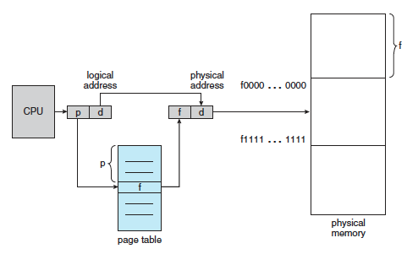
Paging

Slide 5
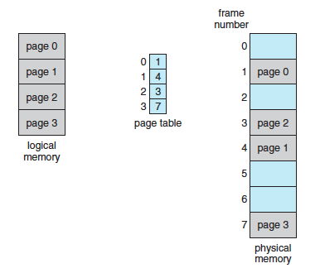
Paging

Slide 6

Paging
The size of a page is a power of 2, varying between 512 bytes and 1 GB per page, depending on the computer architecture.
When we use a paging scheme, we have no external fragmentation: any free frame can be allocated to a process that needs it. However, we may have some internal fragmentation
If the size of the logical address space is 2^{m}, and a page size is 2^{n} bytes, then the high-order m− n bits of a logical address designate the page number, and the n low-order bits designate the page offset

Slide 7
Paging
Here, in the logical address, n= 2 and m = 4. Using a page size of 4 bytes and a physical memory of 32 bytes (8 pages),
Logical address 0 is page 0, offset 0. Indexing into the page table, we find that page 0 is in frame 5. Thus, logical address 0 maps to physical address 20 [= (5 x 4) + 0].
Logical address 3 (page 0, offset 3) maps to physical address 23 [= (5 x 4) +3].
Logical address 4 is page 1, offset 0; according to the page table, page 1 is mapped to frame 6. Thus, logical address 4 maps to physical address 24 [= (6 x 4) + 0].
Logical address 13 maps to physical address 9.

Slide 8
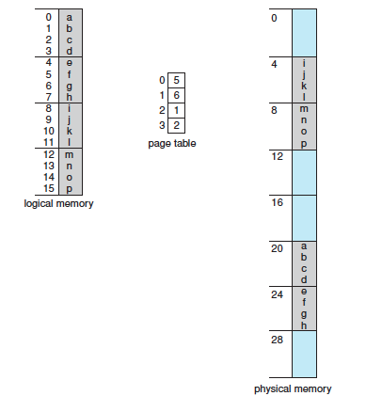
Paging
Here, in the logical address, n= 2 and m = 4. Using a page size of 4 bytes and a physical memory of 32 bytes (8 pages),
Logical address 0 is page 0, offset 0. Indexing into the page table, we find that page 0 is in frame 5. Thus, logical address 0 maps to physical address 20 [= (5 x 4) + 0].
Logical address 3 (page 0, offset 3) maps to physical address 23 [= (5 x 4) +3].

Slide 9
Paging
When we use a paging scheme, we have no external fragmentation: any free frame can be allocated to a process that needs it.
However, we may have some internal fragmentation.
For example, if page size is 2,048 bytes, a process of 72,766 bytes will need 35 pages plus 1,086 bytes.
It will be allocated 36 frames, resulting in internal fragmentation of 2,048 − 1,086 = 962 bytes.

Slide 10
Paging - Implementation
The page table is implemented as a set of dedicated registers and the page table is kept in main memory.
page-table base register (PTBR) points to the page table.
Page-table length register (PRLR) indicates size of the page table.
If we want to access location i, we must first index into the page table, using the value in the PTBR offset by the page number for i. This task requires a memory access. It provides us with the frame number, which is combined with the page offset to produce the actual address.
We can then access the desired place in memory. With this scheme, two memory accesses are needed to access a byte (one for the page-table entry, one for the byte).

Slide 11
Paging - Implementation
The standard solution to this problem is to use a special, small, fast lookup hardware cache called a translation look-aside buffer (TLB) Or Associative memory.
The TLB is associative, high-speed memory. Each entry in the TLB consists of two parts: a key (or tag) and a value.
It is typically between 32 and 1,024 entries in size, so it is very small in size.
The percentage of times that the page number of interest is found in the TLB is called the hit ratio.
If the page number is not in the TLB (known as a TLB miss), a memory reference to the page table must be made.
In addition, we add the page number and frame number to the TLB.
If the TLB is already full of entries, an existing entry must be selected for replacement. Replacement policies range from least recently used (LRU) through round-robin to random.

Slide 12
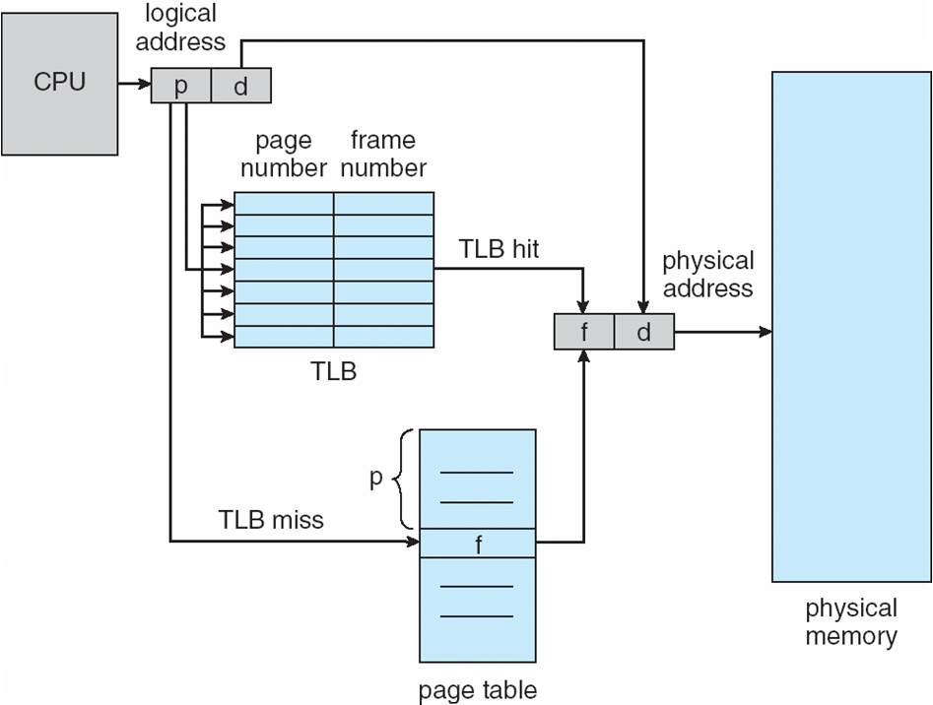
Paging - Implementation
Address translation (p, d)
If p is in associative register, get frame # out
Otherwise get frame # from page table in memory.

Slide 13
Paging - Protection
Memory protection in a paged environment is accomplished by protection bits associated with each frame. Normally, these bits are kept in the page table.
One bit can define a page to be read–write or read-only.
One additional bit is generally attached to each entry in the page table: a valid–invalid bit.
When this bit is set to valid, the associated page is in the process’s logical address space and is thus a legal (or valid) page.
When the bit is set to invalid, the page is not in the process’s logical address space.
Illegal addresses are trapped by use of the valid–invalid bit.
The operating system sets this bit for each page to allow or disallow access to the page.

Slide 14
Paging – Shared Pages
Shared code
One copy of read-only (reentrant) code shared among processes (i.e., text editors, compilers, window systems).
Reentrant code is non-self-modifying code: it never changes during execution. Thus, two or more processes can execute the same code at the same time.
Shared code must appear in same location in the logical address space of all processes.
Each process has its own copy of registers and data storage to hold the data for the process’s execution.
The data for two different processes will, of course, be different.
Only one copy of the editor need be kept in physical memory. Each user’s page table maps onto the same physical copy of the editor, but data pages are mapped onto different frames

Slide 15
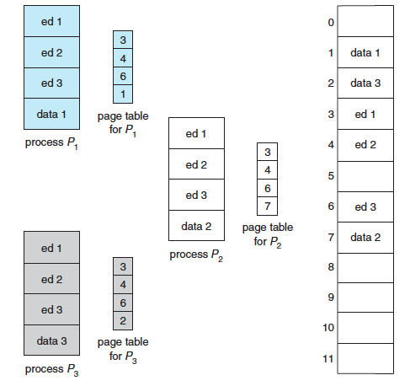
Paging – Shared Pages

Slide 16
Paging – Shared Pages
Shared code
One copy of read-only (reentrant) code shared among processes (i.e., text editors, compilers, window systems).
Reentrant code is non-self-modifying code: it never changes during execution. Thus, two or more processes can execute the same code at the same time.
Shared code must appear in same location in the logical address space of all processes.
Private code and data
Each process keeps a separate copy of the code and data.
The pages for the private code and data can appear anywhere in the logical address space.

Slide 17


THANK YOU

